Slide 1







CodeScope AI: AI-Powered Content Generation for Scalable, Context-Aware Code Solutions
Track: AI-Powered CONTENT GENERATION: CREATE SCALABLE, CONTEXT-AWARE CONTENT SOLUTIONS
Industry: Technology & Software
The Team
Yanxuan Yu (She/Her) - MSc Biomedical Engineering, 2st year
Tanmay Agarwal (He/Him) - MSc Computer Science, 1st year
Haiyue Zhang (He/Him) - MSc Computer Science, 2nd year
Shriya Shivaraman (She/Her) - MSc Mechanical Engineering, 1st year

Slide 2
The Code Comprehension Crisis: Developers Lost in Translation
Modern software development, especially in specialized domains like robotics and aerospace, relies on diverse tech stacks, often encompassing 5–10 programming languages, each with unique syntax and structures. This complexity creates significant bottlenecks.
Time Drain
Onboarding Friction
Knowledge Loss
Developers spend up to 50% of their time simply reading, navigating, and understanding existing code before they can meaningfully contribute or fix bugs.
As codebases grow and diversify, onboarding new engineers is drastically slowed, hindering team scalability and time-to-value for new hires.
Teams lose valuable context behind core logic and design decisions, making cross-language collaboration error-prone and long-term maintenance difficult.
This lack of context and interoperability impedes productivity, slows migrations, and frustrates new learners encountering unfamiliar language paradigms.

Slide 3




CodeScope AI: Context-Aware Code Interpretation
CodeScope AI is a revolutionary developer tool that transforms complex, multi-language codebases into clear, interactive knowledge. We provide instant, accurate, and scalable explanations of code logic, intent, and structure.
Multi-Language Mastery
Instant Contextual Summaries
Interactive Knowledge Graph
Supports 40+ programming languages, interpreting complex logic and dependencies across the entire codebase.
Generates human-readable explanations of functions, classes, and logic flow, eliminating manual code traversal.
Turns static code into a dynamic graph that maps system dependencies and data flow, accelerating debugging and system understanding.

Slide 4

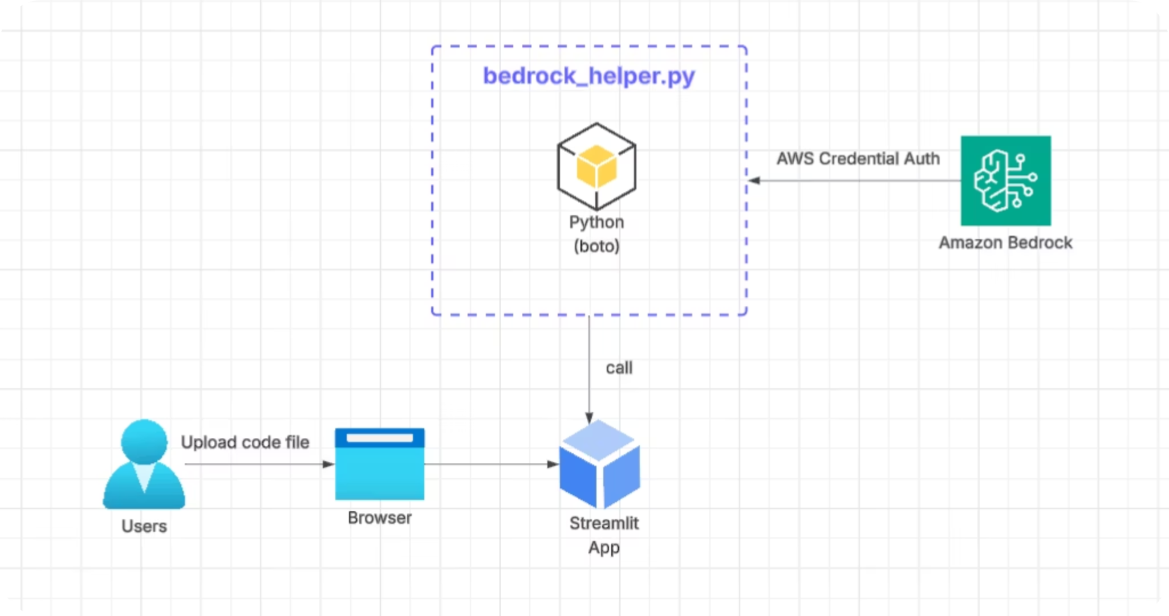

Technical Architecture: Leveraging AWS Bedrock
Our serverless architecture ensures high performance, security, and scalability for analyzing massive codebases. AWS Bedrock is the engine for deep contextual understanding.
The architecture is deployed via Streamlit, providing a clean, accessible interface for developers to paste code snippets or connect to repositories, receiving instant AI-generated explanations and visualizations.

Slide 5




Innovation Edge: Why CodeScope AI Stands Apart
Unified Code Intelligence
Goes beyond syntax highlighting. We understand the logic, dependencies, and flow across diverse languages, offering holistic system insight.
AI-Powered Logic Translation
Leverages Amazon Bedrock (Claude 3 Sonnet + Titan) to interpret code intent and translate core logic between domains and languages, a unique capability in developer tooling.
Scalable Cloud Architecture
Built entirely on AWS Bedrock and Streamlit for a serverless, highly available, and cost-effective deployment that scales with any enterprise codebase size.
Domain Agnostic Applicability
Critical for sectors like robotics, aerospace, and embedded systems where C++, Python, and MATLAB code must interoperate seamlessly.

Slide 6
Accelerating Innovation: Market and Business Impact
CodeScope AI delivers quantifiable returns by dramatically improving developer efficiency and product quality in complex engineering environments.
60%
100%
0
High
Productivity Boost
Enterprise Readiness
Learning Curve
Safety Assurance
Cuts code comprehension time by up to 60%, reducing operational costs in high-complexity industries like autonomous systems and aerospace.
Ideal for companies managing multi-language systems, from low-level robot control firmware (C++) to high-level data processing pipelines (Python/ROS).
Enables students and new engineers to quickly grasp system mechanics by visually learning from real, complex codebases.
Streamlines compliance and safety validation in sectors where software quality equals mission safety, such as aerospace controls and medical devices.

Slide 7

Roadmap to Scalable Code Intelligence
1
Phase 1 – Prototype (Now)
Launch Streamlit app with AWS Bedrock integration. Core function: Language detection and logic explanation (Python, C++, MATLAB) for code summaries and basic visualization.
2
Phase 2 – Expansion (Next 3–6 months)
Add interactive system flow visualization and advanced cross-language translation features. Integrate control-system templates and commence beta testing with specialized research labs.
3
Phase 3 – Future Scope (6–12 months)
Integrate directly into industry simulation pipelines (ROS, Simulink). Implement Intelligent Debugging to detect logic anomalies and launch "coach" view for engineering education. Scale via AWS Marketplace.

